Slide 1
1. Introduction
2. Understanding Hazards
3. Understanding Risk
4. Risk Assessment
5. Risk Management
6. Review
Section 1 – Introduction
In this module you will learn what Risk Management is all about.
There are 6 sections that will cover:
Introduction – what risk management is and why it is important.
Understanding Hazards - what a hazard is and the sources of energy that can cause them.
Understanding Risk – what is risk
Risk Assessment – how to assess risk
Risk Management – the process used in the workplace that deals with controlling risk and prevents harm to people and property.
Review – a summary of the key concepts learned.
1 of 13

Slide 2
1. Introduction
2. Understanding Hazards
3. Understanding Risk
4. Risk Assessment
5. Risk Management
6. Review
Section 1 – Introduction
In order to understand Risk Management you will learn some new terms and the context in which they are used. Terms will be defined as you go through the module.
There is a lot to remember – so if you want to take notes as you go – click on the notepad and jot down key points you want to remember.
-or –
You can print any screen that you want to use to help you remember.
2 of 13

Slide 3
1. Introduction
2. Understanding Hazards
3. Understanding Risk
4. Risk Assessment
5. Risk Management
6. Review
Section 1 – Introduction
So why is this so important in the work place?
Let’s have a look at a few workplaces.
See if you think if the risks in these workplaces were well managed.
3 of 13

Slide 4
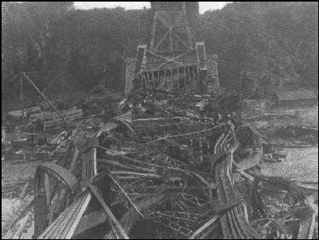
1. Introduction
2. Understanding Hazards
3. Understanding Risk
4. Risk Assessment
5. Risk Management
6. Review
Section 1 – Introduction
It took only 15 seconds for the bridge to collapse
75 workers died
The remaining 11 workers were all injured
A Royal Commission concluded in 1908 that the bridge was improperly designed, the beams were too small for the load placed on them.
Quebec Bridge Collapse
August 29, 1907
Source: Royal Commission Quebec Bridge Inquiry Report 1908
4 of 13

Slide 5
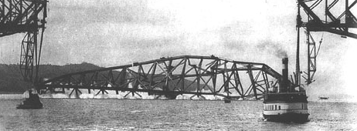
1. Introduction
2. Understanding Hazards
3. Understanding Risk
4. Risk Assessment
5. Risk Management
6. Review
Section 1 – Introduction
The Second Quebec Bridge Collapse
September 11, 1916
Source: thecanadianencyclopedia.com
Construction resumed after the Royal Commission. The bridge was almost finished when a second accident occurred – this time the middle span collapsed killing 13 workers.
The cause of the accident was found to be a problem with the hoisting device.
5 of 13

Slide 6
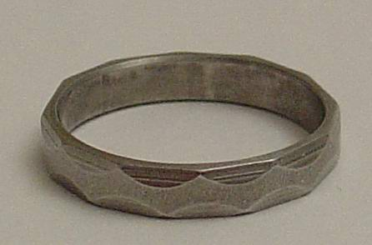
1. Introduction
2. Understanding Hazards
3. Understanding Risk
4. Risk Assessment
5. Risk Management
6. Review
Section 1 – Introduction
Shortly after the second bridge collapse, the seven past presidents of the Engineering Institute of Canada came up with the idea of a ceremony for the Obligation of Canadian Engineers (1922).
At the ceremony, an iron ring worn is given to new engineers and is to be worn on the smallest finger of an engineer’s writing hand.
It symbolizes the pride engineers have in their profession, and reminds them of their humility.
The ring also serves as a reminder to the engineer of their obligation to live by a high standard. professional conduct.
Photo: commons.wikimedia.org
6 of 13

Slide 7
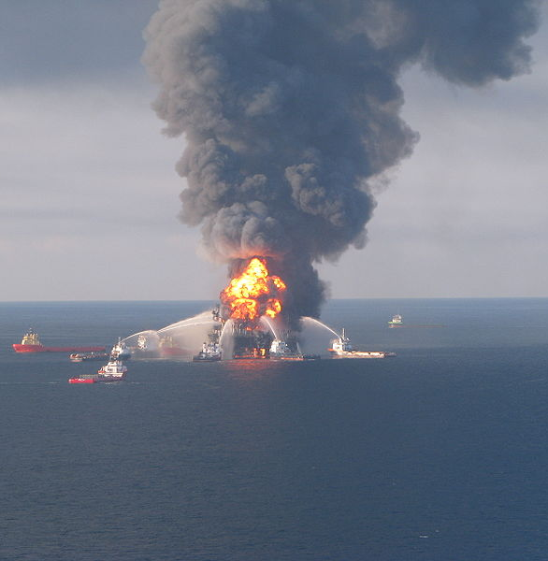
1. Introduction
2. Understanding Hazards
3. Understanding Risk
4. Risk Assessment
5. Risk Management
6. Review
Section 1 – Introduction
“On the evening of April 10, 2010 a well control event allowed hydrocarbons to escape from the Macondo well onto Transocean’s Deepwater Horizon, resulting in explosions and fire on the rig.”
from British Petroleums ‘Deepwater Horizon Accident Investigation Report, September 8, 2010’
Photo: commons.wikimedia.org
7 of 13

Slide 8
1. Introduction
2. Understanding Hazards
3. Understanding Risk
4. Risk Assessment
5. Risk Management
6. Review
Section 1 – Introduction
11 people died
17 were injured
The fire continued for 36 hours before the rig sank.
Oil flowed into the Gulf of Mexico for 87 days
409 million barrels of oil were spilled into the Gulf
from British Petroleum’s ‘Deepwater Horizon Accident Investigation Report, September 8, 2010’
Photo: commons.wikimedia.org
Deepwater Horizon Oil Rig
April 10, 2010
8 of 13

Slide 9
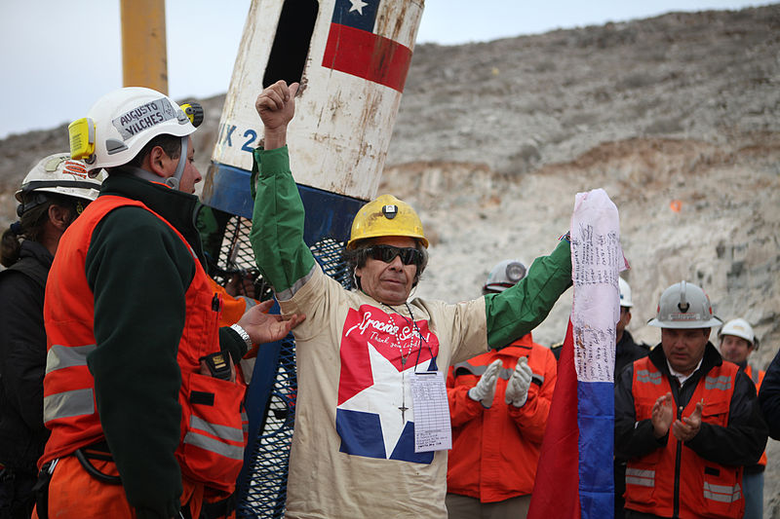
1. Introduction
2. Understanding Hazards
3. Understanding Risk
4. Risk Assessment
5. Risk Management
6. Review
Section 1 – Introduction
A mine collapse on August 5, 2010 trapped 33 miners 2,300 feet underground.
69 days later on October 13th the men were rescued using a 21 inch diameter capsule.
Rescue of 33 Chilean Miners
October 13, 2010
Photo: commons.wikimedia.org
9 of 13

Slide 10
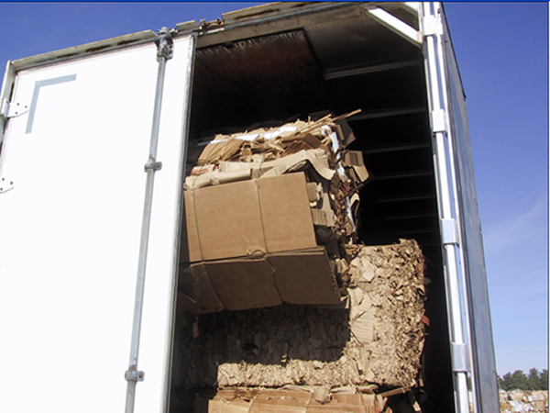
1. Introduction
2. Understanding Hazards
3. Understanding Risk
4. Risk Assessment
5. Risk Management
6. Review
Section 1 – Introduction
Most accidents in the workplace are smaller in scale than the examples you have just seen. They are just as important because even though they are small, they can result in a fatality.
For example, a worker was killed when he opened the door and this unsecured load fell on him.
Workplace Safety North
Hazard Alert Bulletin
March 23, 2013
10 of 13

Slide 11
1. Introduction
2. Understanding Hazards
3. Understanding Risk
4. Risk Assessment
5. Risk Management
6. Review
Section 1 – Introduction
Risk is a situation involving exposure to danger. In the workplace, these risks are managed in order to protect workers and the workplace from harm.
Fortunately, there is a lot that can be done to identify hazards and understand the associated risk so that everyone can work safely.
In the following sections you will learn to:
1. Understand Hazards
2. Understand Risk
3. Manage Risks to prevent harm
11 of 13

Slide 12
1. Introduction
2. Understanding Hazards
3. Understanding Risk
4. Risk Assessment
5. Risk Management
6. Review
Section 1 – Test Your Knowledge
Accidents just happen, there isn’t anything you can do to prevent them.
True
False
SUBMIT
12 of 13

Slide 13
1. Introduction
2. Understanding Hazards
3. Understanding Risk
4. Risk Assessment
5. Risk Management
6. Review
Section 1 – Test Your Knowledge
2. Identifying hazards and risks in the workplace can help reduce the number of accidents and fatalities for workers.
True
False
SUBMIT
13 of 13

Slide 14
1. Introduction
2. Understanding Hazards
3. Understanding Risk
4. Risk Assessment
5. Risk Management
6. Review
To Identify
In this section you will learn what a hazard is and how to identify it.
A hazard is a source of potential harm.
An unwanted event is a potential situation where the hazard can be released.
1 of 12

Slide 15
1. Introduction
2. Understanding Hazards
3. Understanding Risk
4. Risk Assessment
5. Risk Management
6. Review
To Identify
You can prevent an unwanted event.
First identify the hazard.
Do this by looking for a source of energy.
Energy
Hazard–Source of Potential Harm
Gravity
Electricity
Mechanical
Chemical
Pressure
Noise
Thermal
Radiant
Body Mechanics
Falling or things falling
Contact or arcing
Moving equipment or moving parts
Inhalation, touching or ingesting
Air or a spring or compressed gas
How loud and how long you hear it
Hot or cold
Light or radiation
Lifting or body position
2 of 12

Slide 16
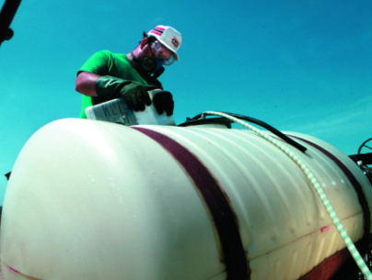
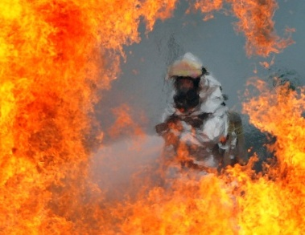
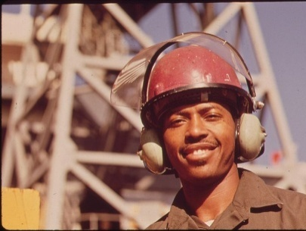
1. Introduction
2. Understanding Hazards
3. Understanding Risk
4. Risk Assessment
5. Risk Management
6. Review
Now you try it - drag the type of energy to its hazard (source of potential harm).
Gravity
Noise
Chemical
Radiant
Picture of Welder or smelter worker in heat suit
Picture of Bottle of Acid or drum of a chemical
Picture of worker
with earmuffs on
3 of 12

Slide 17
1. Introduction
2. Understanding Hazards
3. Understanding Risk
4. Risk Assessment
5. Risk Management
6. Review
Now you try it - drag the type of energy to its hazard (source of potential harm).
Picture of Welder or smelter worker in heat suit
Picture of Bottle of Acid or drum of a chemical
Picture of worker
with earmuffs on
Chemical
Radiant
Gravity
Noise
3 of 12

Slide 18
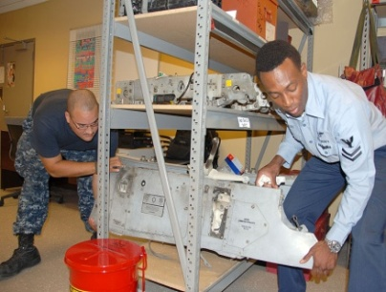
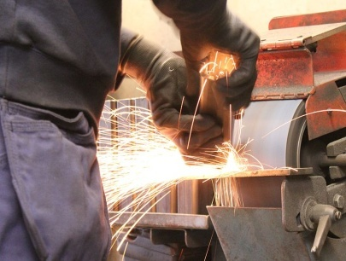
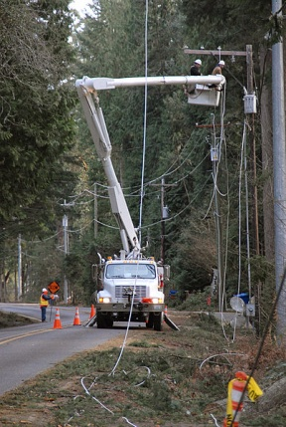
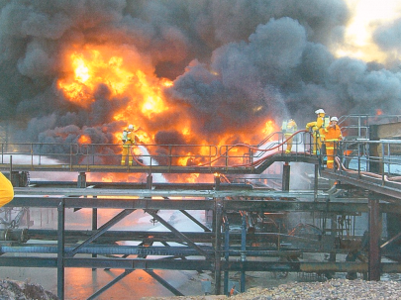
1. Introduction
2. Understanding Hazards
3. Understanding Risk
4. Risk Assessment
5. Risk Management
6. Review
Try these too - drag the type of energy to its hazard.
Body Mechanics
Electrical
Pressure
Thermal
Mechanical
Picture of Smelter Worker in Heat Suit
4 of 12

Slide 19
1. Introduction
2. Understanding Hazards
3. Understanding Risk
4. Risk Assessment
5. Risk Management
6. Review
Try these too - drag the type of energy to its hazard.
Body Mechanics
Pressure
Mechanical
Picture of Smelter Worker in Heat Suit
Electrical
Thermal
4 of 12

Slide 20
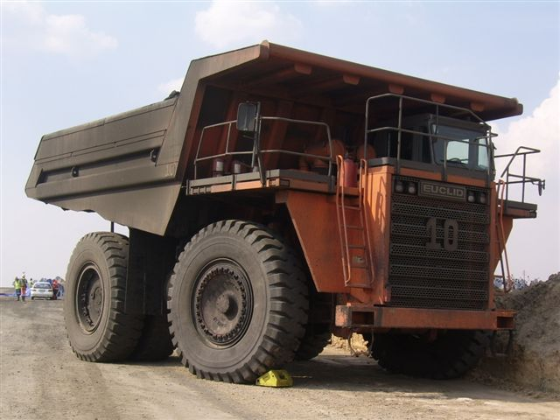
1. Introduction
2. Understanding Hazards
3. Understanding Risk
4. Risk Assessment
5. Risk Management
6. Review
To Identify
Case Study
The large truck below is often used in open pit mining and is an example of a mechanical hazard.
These trucks are heavy and can move at speeds of up to 50 km/hr. They cannot stop quickly and vehicle collisions are possible.
Operator visibility is also limited – note the operator’s cab on the far right of the picture.
The box on the back of the truck limits the operator’s view to their right and behind.
Operator’s Cab
5 of 12

Slide 21
1. Introduction
2. Understanding Hazards
3. Understanding Risk
4. Risk Assessment
5. Risk Management
6. Review
To Identify
In this scenario the possibility of collision exists in several different ways; between:
the two large trucks,
the smaller white cab truck and a large truck,
the large truck and the shovel in the background, or
The small white cab truck and the shovel.
Click on the button below to see how the hazard became a reality…
SHOW ME THE HAZARD
6 of 12

Slide 22
1. Introduction
2. Understanding Hazards
3. Understanding Risk
4. Risk Assessment
5. Risk Management
6. Review
#1
#2
small pickup truck
Notice the small pick up truck between the wheels of the truck #1.
In this case the driver of truck #1 was watching for the hazard of truck #2 to its left and didn’t see the small pickup truck that it ran over.
7 of 12

Slide 23
1. Introduction
2. Understanding Hazards
3. Understanding Risk
4. Risk Assessment
5. Risk Management
6. Review
The best way to deal with hazards is to eliminate them. If this is not possible, then controls are needed to reduce the risk of harm. Click on each layer of the pyramid to the most effective way to deal with hazards.
#1
Most Effective
#2
#3
#4
#5
Least Effective
8 of 12

Slide 24
1. Introduction
2. Understanding Hazards
3. Understanding Risk
4. Risk Assessment
5. Risk Management
6. Review
The best way to deal with hazards is to eliminate them. If this is not possible, then controls are needed to reduce the risk of harm. Click on each layer of the pyramid to the most effective way to deal with hazards.
Elimination
Most Effective
Substitution
Engineering
Administration
PPE
Least Effective
Personal Protective Equipment (PPE) should always be your last choice.
9 of 12

Slide 25
1. Introduction
2. Understanding Hazards
3. Understanding Risk
4. Risk Assessment
5. Risk Management
6. Review
Elimination
A tripping hazard (such as a floor mat) can be eliminated by removing the mat.
Substitution
Use a non-flammable hydraulic oil in equipment with hot engines.
Engineering
A cover can be designed to cover moving parts on a machine.
Administration
A policy can be written that employees are not to enter the shop when welding is taking place.
PPE
Rubber gloves must be worn when handling bleach.
10 of 12

Slide 26
1. Introduction
2. Understanding Hazards
3. Understanding Risk
4. Risk Assessment
5. Risk Management
6. Review
Section 2 – Test Your Knowledge
Which of the following are hazards?
a) full acetylene bottle, open electrical panel, and fire
b) boxes stacked too high; used hypodermic needle
c) electrical energy and mechanical energy
d) container of gasoline, hot cooking oil
e) all of the above
f) a and b only
h) a, b and d only
SUBMIT
11 of 12

Slide 27
1. Introduction
2. Understanding Hazards
3. Understanding Risk
4. Risk Assessment
5. Risk Management
6. Review
Section 2 – Test Your Knowledge
2. Which of the following are sources of energy?
a) pressure
b) body mechanics
c) noise
d) gravity
e) thermal
f) all of the above
g) none of the above
SUBMIT
12 of 12

Slide 28
1. Introduction
2. Understanding Hazards
3. Understanding Risk
4. Risk Assessment
5. Risk Management
6. Review
Section 3 – Understanding Risk
Now that you have learned what a hazard is and how to identify it based on its source of energy, the next step is to understand what risk is and how to assess it.
Risk is the chance of something happening that will have a negative impact on objectives.
Let’s explore the concept of risk in a little more detail.
1 of 15

Slide 29
1. Introduction
2. Understanding Hazards
3. Understanding Risk
4. Risk Assessment
5. Risk Management
6. Review
Section 3 – Understanding Risk
Risk is defined as:
Probability of Occurrence x Consequence of the Outcome
So let’s go back to the example of the unsecured load in the back of the truck and look at the probability of occurrence.
2 of 15

Slide 30
1. Introduction
2. Understanding Hazards
3. Understanding Risk
4. Risk Assessment
5. Risk Management
6. Review
Section 3 – Understanding Risk
The probability (or chance) that a worker could get hurt depends on different factors.
For example, two companies are responsible for loading the truck. Company #1 doesn’t train its employees to secure loads, and company #2 does.
The probability of this type of accident is higher for company #1 because it employees don’t secure loads.
Workplace Safety North
Hazard Alert Bulletin
March 23, 2013
3 of 15

Slide 31
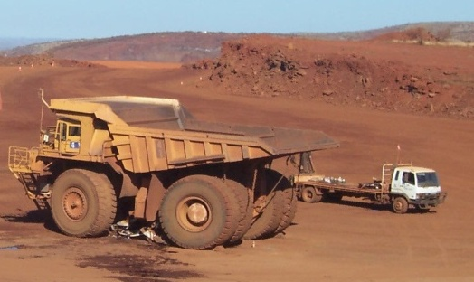
1. Introduction
2. Understanding Hazards
3. Understanding Risk
4. Risk Assessment
5. Risk Management
6. Review
Section 3 – Understanding Risk
The consequence of the outcome is the second part of the risk equation.
It means if the unwanted event occurs, how bad can the outcome be?
It’s obvious that outcome of running over a pickup truck is severe. Not only is there damage to property, but there may be a loss of life if the vehicle was occupied.
4 of 15

Slide 32
1. Introduction
2. Understanding Hazards
3. Understanding Risk
4. Risk Assessment
5. Risk Management
6. Review
Section 3 – Understanding Risk
Section 3 – Understanding Risk
So if the Probability of Occurrence =
and the Consequence of the Outcome =
then the Risk of an unwanted event is
HIGH
HIGH
HIGH
HIGH
HIGH
(Probability of Occurrence)
(Outcome Consequence)
(Risk)
5 of 15

Slide 33
1. Introduction
2. Understanding Hazards
3. Understanding Risk
4. Risk Assessment
5. Risk Management
6. Review
Section 3 – Understanding Risk
Let’s try a few examples. First decide on the probability of the following:
Probability of Occurrence
An empty box sits on the bottom shelf in a storage room. What is the probability the box will fall off the shelf?
High
Medium
Low
6 of 15

Slide 34
1. Introduction
2. Understanding Hazards
3. Understanding Risk
4. Risk Assessment
5. Risk Management
6. Review
Section 3 – Understanding Risk
The answer is Low, because it’s on the bottom shelf and out of the way. Now decide what the consequence would be if the box did fall off the shelf.
Probability of Occurrence
Consequence of Outcome
The box is empty so there are no contents that would be damaged. Someone might trip over the box.
High
Low
Medium
Low
7 of 15

Slide 35
1. Introduction
2. Understanding Hazards
3. Understanding Risk
4. Risk Assessment
5. Risk Management
6. Review
Section 3 – Understanding Risk
The answer is Low, because very little damage to a person or property would result. The overall risk in this case is Low.
Probability of Occurrence
Consequence of Outcome
Risk
Low
Low
Low
8 of 15

Slide 36
1. Introduction
2. Understanding Hazards
3. Understanding Risk
4. Risk Assessment
5. Risk Management
6. Review
Section 3 – Understanding Risk
How would the risk change if the box were sitting on the edge of the middle shelf, that is about a metre off the floor and it contains electronic equipment that weighs 10 kilograms? Click the ? to place the correct word in the box.
Probability of Occurrence
Consequence of Outcome
Risk
?
?
?
9 of 15

Slide 37
1. Introduction
2. Understanding Hazards
3. Understanding Risk
4. Risk Assessment
5. Risk Management
6. Review
Section 3 – Understanding Risk
The probability of the box falling off the shelf has increased because the shelf is higher and the box is on the edge.
The consequence of the outcome is also higher because the equipment will likely be damaged in the fall. The box is also heavy and if it lands on a person’s foot, it could break the bones in the foot.
Probability of Occurrence
Consequence of Outcome
Risk
Medium
Medium
Medium
10 of 15

Slide 38
1. Introduction
2. Understanding Hazards
3. Understanding Risk
4. Risk Assessment
5. Risk Management
6. Review
Section 3 – Understanding Risk
Let’s try one more. How would the risk change if the box were sitting on the edge of the top shelf, that is about 2 metres off the floor? The box contains glass bottles of a very strong acid and weighs 20 kilograms. When the door to the storage room opens, it pushes the box towards the edge.
Probability of Occurrence
Consequence of Outcome
Risk
?
?
?
11 of 15

Slide 39
1. Introduction
2. Understanding Hazards
3. Understanding Risk
4. Risk Assessment
5. Risk Management
6. Review
Section 3 – Understanding Risk
The probability of the box falling off the shelf has increased because the shelf is higher and the box is being pushed off the edge.
The consequence of the outcome is also higher because not only will the glass bottles break in the fall, the acid could spill on a person and burn their skin or eyes.
Probability of Occurrence
Consequence of Outcome
Risk
High
High
High
12 of 15

Slide 40
1. Introduction
2. Understanding Hazards
3. Understanding Risk
4. Risk Assessment
5. Risk Management
6. Review
Section 3 – Test Your Knowledge
The definition of Risk is:
a) the chance that something happening will have a positive impact on objectives.
b) the chance that something happening will have a negative impact on objectives.
c) the change that something happening will not have an impact on objectives.
d) none of the above.
SUBMIT
13 of 15

Slide 41
1. Introduction
2. Understanding Hazards
3. Understanding Risk
4. Risk Assessment
5. Risk Management
6. Review
Section 3 – Test Your Knowledge
2. In the example where a worker was killed when an unsecured load fell on them when they opened the back door of the truck, what was the energy source of the hazard?
a) Gravity
b) Mechanical
c) Electrical
d) Biological
SUBMIT
14 of 15

Slide 42
1. Introduction
2. Understanding Hazards
3. Understanding Risk
4. Risk Assessment
5. Risk Management
6. Review
Section 3 – Test Your Knowledge
3. What is the probability of a worker getting hurt when opening the back of a semi-trailer that has unsecured loads inside?
a) low
b) medium
c) high
SUBMIT
15 of 15

Slide 43
1. Introduction
2. Understanding Hazards
3. Understanding Risk
4. Risk Assessment
5. Risk Management
6. Review
Section 4 – Risk Assessment
In order to do a quality Risk Assessment you must:
First, identify and understand the hazards, and
Second, identify and assess the risks.
Risk assessment can be done in a number of ways, fortunately there are tools that can help make it easier. In this section you are going to learn a few different tools to help you understand how risk is analyzed.
1 of 37

Slide 44
1. Introduction
2. Understanding Hazards
3. Understanding Risk
4. Risk Assessment
5. Risk Management
6. Review
Section 4 – Risk Assessment Tools
There are many different Risk Assessment tools. Each provides a different perspective and insight into a workplace’s hazards.
Some are simpler to use and have a smaller effect. Other methods are more complex, however they offer increased effect and insight.
Click on each box to see the full name of each tool.
Checklist
QRM
FMECA
HAZOP
FTL
Increased
Effect & Insight
Less Effect
2 of 37

Slide 45
1. Introduction
2. Understanding Hazards
3. Understanding Risk
4. Risk Assessment
5. Risk Management
6. Review
Section 4 – Risk Assessment Tools
There are many different Risk Assessment tools. Each provides a different perspective and insight into a workplace’s hazards.
Some are simpler to use and have a smaller effect. Other methods are more complex, however they offer increased effect and insight.
Click on each box to see the full name of each tool.
Checklist
Checklist
QRM
FMECA
HAZOP
FTL
Increased
Effect & Insight
Less Effect
2 of 37

Slide 46
1. Introduction
2. Understanding Hazards
3. Understanding Risk
4. Risk Assessment
5. Risk Management
6. Review
Section 4 – Risk Assessment Tools
There are many different Risk Assessment tools. Each provides a different perspective and insight into a workplace’s hazards.
Some are simpler to use and have a smaller effect. Other methods are more complex, however they offer increased effect and insight.
Click on each box to see the full name of each tool.
Qualitative Risk Matrix
Checklist
QRM
FMECA
HAZOP
FTL
Increased
Effect & Insight
Less Effect
2 of 37

Slide 47
1. Introduction
2. Understanding Hazards
3. Understanding Risk
4. Risk Assessment
5. Risk Management
6. Review
Section 4 – Risk Assessment Tools
There are many different Risk Assessment tools. Each provides a different perspective and insight into a workplace’s hazards.
Some are simpler to use and have a smaller effect. Other methods are more complex, however they offer increased effect and insight.
Click on each box to see the full name of each tool.
Failure Modes, Effects and Criticality Analysis
Checklist
QRM
FMECA
HAZOP
FTL
Increased
Effect & Insight
Less Effect
2 of 37

Slide 48
1. Introduction
2. Understanding Hazards
3. Understanding Risk
4. Risk Assessment
5. Risk Management
6. Review
Section 4 – Risk Assessment Tools
There are many different Risk Assessment tools. Each provides a different perspective and insight into a workplace’s hazards.
Some are simpler to use and have a smaller effect. Other methods are more complex, however they offer increased effect and insight.
Click on each box to see the full name of each tool.
Hazard and Operability Analysis
Checklist
QRM
FMECA
HAZOP
FTL
Increased
Effect & Insight
Less Effect
2 of 37

Slide 49
1. Introduction
2. Understanding Hazards
3. Understanding Risk
4. Risk Assessment
5. Risk Management
6. Review
Section 4 – Risk Assessment Tools
There are many different Risk Assessment tools. Each provides a different perspective and insight into a workplace’s hazards.
Some are simpler to use and have a smaller effect. Other methods are more complex, however they offer increased effect and insight.
Click on each box to see the full name of each tool.
Fault Tree Logic
Checklist
QRM
FMECA
HAZOP
FTL
Increased
Effect & Insight
Less Effect
2 of 37

Slide 50
1. Introduction
2. Understanding Hazards
3. Understanding Risk
4. Risk Assessment
5. Risk Management
6. Review
Section 4 – Risk Assessment Tools
There are many different Risk Assessment tools. Each provides a different perspective and insight into a workplace’s hazards.
Some are simpler to use and have a smaller effect. Other methods are more complex, however they offer increased effect and insight.
Click on each box to see the full name of each tool.
Bow Tie Analysis
Checklist
QRM
FMECA
HAZOP
FTL
Increased
Effect & Insight
Less Effect
2 of 37

Slide 51
1. Introduction
2. Understanding Hazards
3. Understanding Risk
4. Risk Assessment
5. Risk Management
6. Review
Section 4 – Risk Assessment Tools
In order to select the right tool, you need to understand how each one works and which risk situation it is best suited to.
Let’s look at three of the tools so you can get an idea of what is meant by effect and insight.
We’ll also try a few examples so you can see how they can be used.
3 of 37

Slide 52
1. Introduction
2. Understanding Hazards
3. Understanding Risk
4. Risk Assessment
5. Risk Management
6. Review
Section 4 – Checklist
Section 4 – Risk Analysis Methods
Checklist
This type of risk assessment is a systematic evaluation of a risk item against a pre-established criteria in the form of a checklist.
The checklist is developed usually from historical knowledge of the risk, interviews, documentation reviews and field inspections.
Can be performed by an individual trained in the subject area or by a small group.
4 of 37

Slide 53
1. Introduction
2. Understanding Hazards
3. Understanding Risk
4. Risk Assessment
5. Risk Management
6. Review
Section 4 – Checklist
Section 4 – Risk Analysis Methods
The checklist generates qualitative lists of items that either conform to the checklist or are found deficient. Recommendations are made to correct deficiencies.
The quality of the evaluation is determined primarily by the experience of people creating the checklists and the training of the checklist users.
It has less effect because it provides a minimal amount of information.
5 of 37

Slide 54
1. Introduction
2. Understanding Hazards
3. Understanding Risk
4. Risk Assessment
5. Risk Management
6. Review
Section 4 – Checklist
Section 4 – Risk Analysis Methods
This tool has less insight than some of the more complex methods because the checklist is predetermined and not as likely to identify new potential hazards.
It is useful applied at the beginning of a project and then used again as an outline for a subsequent analysis.
A simple example of a checklist is shown on the next slide.
6 of 37

Slide 55
1. Introduction
2. Understanding Hazards
3. Understanding Risk
4. Risk Assessment
5. Risk Management
6. Review
Section 4 – Checklist
Section 4 – Risk Analysis Methods
Checklist for a Vessel’s Compressed Air System
Questions | Responses | Recommendations
Piping
Have thermal relief valves been installed in piping runs where thermal expansion of trapped fluids could separate flanges? | Not applicable
Compressors
Are air compressors intakes protected against contaminants such as rain, animals, flammable gases?) | Yes, except for animals. | Consider installing a wire mesh over the inlet.
The checklist is easy to use and faster than other methods.
It is straight forward and structured but does restrict ideas.
7 of 37

Slide 56
1. Introduction
2. Understanding Hazards
3. Understanding Risk
4. Risk Assessment
5. Risk Management
6. Review
Section 4 – Qualitative Risk Assessment
Section 4 – Risk Analysis Methods
QRM
This type of risk assessment is useful to evaluate and prioritize areas that may be vulnerable to an unwanted event in a workplace.
It can help a team identify the risks with the highest probability and most severe consequences. In this way the risks can be dealt with quickly to reduce the chance of harm to a worker.
Let’s look at an example on the next slide.
8 of 37

Slide 57
1. Introduction
2. Understanding Hazards
3. Understanding Risk
4. Risk Assessment
5. Risk Management
6. Review
Section 4 – Qualitative Risk Assessment
Section 4 – Risk Analysis Methods
First a risk matrix is created using the risk definition of :
Probability of Occurrence x Consequence of the Outcome.
Consequence
 | 1 Insignificant | 2 Minor | 3 Moderate | 4 Major | 5 Catastrophic
5 Certain | HIGH | HIGH | EXTREME | EXTREME | EXTREME
4 Likely | MEDIUM | HIGH | HIGH | EXTREME | EXTREME
3 Possible | LOW | MEDIUM | HIGH | EXTREME | EXTREME
2 Unlikely | LOW | LOW | MEDIUM | HIGH | EXTREME
1 Rare | LOW | LOW | MEDIUM | MEDIUM | HIGH
Probability
9 of 37

Slide 58
1. Introduction
2. Understanding Hazards
3. Understanding Risk
4. Risk Assessment
5. Risk Management
6. Review
Section 4 – Qualitative Risk Assessment
Section 4 – Risk Analysis Methods
Definitions – Probability (Likelihood)
Definitions for the terms in the matrix are needed for both the likelihood (probability) and consequence.
Certain
Likely to occur often during the life of the operation
Likely
Likely to occur several times in the life of the operation
Possible
Likely to occur sometime in the life of the operation
Unlikely
Unlikely, but possible to occur.
Rare
So unlikely it is assumed not to occur .
10 of 37

Slide 59
1. Introduction
2. Understanding Hazards
3. Understanding Risk
4. Risk Assessment
5. Risk Management
6. Review
Section 4 – Qualitative Risk Assessment
Section 4 – Risk Analysis Methods
Definitions – Consequence
Catastrophic
Death, loss of plant, release to environment with pubic interest, regulatory intervention occurs
Major
Permanent impairment, serious lost time injury, partial loss of plant, lesser release to environment
Moderate
Lost time injury (short term), short term loss of plant, recoverable release to the environment
Minor
Minor injury, minor damage to plant, minor confined environmental exposure
Insignificant
Very minor incident, less than any of the above.
11 of 37

Slide 60
1. Introduction
2. Understanding Hazards
3. Understanding Risk
4. Risk Assessment
5. Risk Management
6. Review
Section 4 – Qualitative Risk Assessment
Section 4 – Risk Analysis Methods
Let’s do a risk assessment on the unsecured load. The company has had 3 other incidences similar to this one in the last year. Two were near misses where no one was hurt and one resulted in a broken leg.
12 of 37

Slide 61
1. Introduction
2. Understanding Hazards
3. Understanding Risk
4. Risk Assessment
5. Risk Management
6. Review
Section 4 – Qualitative Risk Assessment
Section 4 – Risk Analysis Methods
Definitions – Probability (Likelihood)
Given it has happened 4 times in the last year, this is certain to happen again.
What about the consequence?
Certain
Likely to occur often during the life of the operation
Likely
Likely to occur several times in the life of the operation
Possible
Likely to occur sometime in the life of the operation
Unlikely
Unlikely, but possible to occur.
Rare
So unlikely it is assumed not to occur .
13 of 37

Slide 62
1. Introduction
2. Understanding Hazards
3. Understanding Risk
4. Risk Assessment
5. Risk Management
6. Review
Section 4 – Qualitative Risk Assessment
Section 4 – Risk Analysis Methods
Since a fatality occurred, the consequence is catastrophic.
Catastrophic
Death, loss of plant, release to environment with public interest, regulatory intervention occurs
Major
Permanent impairment, serious lost time injury, partial loss of plant, lesser release to environment
Moderate
Lost time injury (short term), short term loss of plant, recoverable release to the environment
Minor
Minor injury, minor damage to plant, minor confined environmental exposure
Insignificant
Very minor incident, less than any of the above.
14 of 37

Slide 63
1. Introduction
2. Understanding Hazards
3. Understanding Risk
4. Risk Assessment
5. Risk Management
6. Review
Section 4 – Qualitative Risk Assessment
Section 4 – Risk Analysis Methods
With a Probability of Certain and a Consequence of Catastrophic, the unsecured load has been identified as an extreme hazard and immediate changes by the company need to take place to ensure the safety of its workers.
 | Consequence
 | 1 Insignificant | 2 Minor | 3 Moderate | 4 Major | 5 Catastrophic
5 Certain | HIGH | HIGH | EXTREME | EXTREME | EXTREME
4 Likely | MEDIUM | HIGH | HIGH | EXTREME | EXTREME
3 Possible | LOW | MEDIUM | HIGH | EXTREME | EXTREME
2 Unlikely | LOW | LOW | MEDIUM | HIGH | EXTREME
1 Rare | LOW | LOW | MEDIUM | MEDIUM | HIGH
Probability
15 of 37

Slide 64
1. Introduction
2. Understanding Hazards
3. Understanding Risk
4. Risk Assessment
5. Risk Management
6. Review
Section 4 – Qualitative Risk Assessment
Section 4 – Risk Analysis Methods
Had the company done a risk assessment after the first near miss, and then taken some corrective actions, the probability may have been “possible”.
The consequence would still have been “major” or “catastrophic” because it isn’t too hard to see that a load falling from that height could kill or seriously injure someone.
The risk matrix still shows that this is an extreme hazard and warrants immediate changes to the company’s policy and procedures. This proactive approach to assessing risk provides a much safer work environment.
16 of 37

Slide 65
1. Introduction
2. Understanding Hazards
3. Understanding Risk
4. Risk Assessment
5. Risk Management
6. Review
Section 4 – Qualitative Risk Assessment
Section 4 – Risk Analysis Methods
 | Consequence
 | 1 Insignificant | 2 Minor | 3 Moderate | 4 Major | 5 Catastrophic
5 Certain | HIGH | HIGH | EXTREME | EXTREME | EXTREME
4 Likely | MEDIUM | HIGH | HIGH | EXTREME | EXTREME
3 Possible | LOW | MEDIUM | HIGH | EXTREME | EXTREME
2 Unlikely | LOW | LOW | MEDIUM | HIGH | EXTREME
1 Rare | LOW | LOW | MEDIUM | MEDIUM | HIGH
Probability
Compared to the Checklist method, you can see how this method has more effect and insight.
17 of 37

Slide 66
1. Introduction
2. Understanding Hazards
3. Understanding Risk
4. Risk Assessment
5. Risk Management
6. Review
Section 4 – Failure Modes, Effects & Criticality Analysis
Section 4 – Risk Analysis Methods
FMECA
This type of analysis is done to determine proactively where a failure in the hardware of a system may occur and to assess the impact of each possible failure. Start on the bottom step and press on each step to learn more.
List
Failure Modes
Determine Effects
Evaluate Effects
Control
18 of 37

Slide 67
1. Introduction
2. Understanding Hazards
3. Understanding Risk
4. Risk Assessment
5. Risk Management
6. Review
Section 4 – Failure Modes, Effects & Criticality Analysis
Section 4 – Risk Analysis Methods
This type of analysis is done to determine proactively where a failure in the hardware of a system may occur and to assess the impact of each possible failure. Start on the bottom step and press on each step to learn more.
List
Failure Modes
Determine Effects
Evaluate Effects
Control
List of each part of the hardware that could fail.
18 of 37

Slide 68
1. Introduction
2. Understanding Hazards
3. Understanding Risk
4. Risk Assessment
5. Risk Management
6. Review
Section 4 – Failure Modes, Effects & Criticality Analysis
Section 4 – Risk Analysis Methods
This type of analysis is done to determine proactively where a failure in the hardware of a system may occur and to assess the impact of each possible failure. Start on the bottom step and press on each step to learn more.
List
Failure Modes
Determine Effects
Evaluate Effects
Control
For each item, list the way in which the part could fail.
18 of 37

Slide 69
1. Introduction
2. Understanding Hazards
3. Understanding Risk
4. Risk Assessment
5. Risk Management
6. Review
Section 4 – Failure Modes, Effects & Criticality Analysis
Section 4 – Risk Analysis Methods
This type of analysis is done to determine proactively where a failure in the hardware of a system may occur and to assess the impact of each possible failure. Start on the bottom step and press on each step to learn more.
List
Failure Modes
Determine Effects
Evaluate Effects
Control
Determine what is the effect on the item and the system for each failure mode.
18 of 37

Slide 70
1. Introduction
2. Understanding Hazards
3. Understanding Risk
4. Risk Assessment
5. Risk Management
6. Review
Section 4 – Failure Modes, Effects & Criticality Analysis
Section 4 – Risk Analysis Methods
This type of analysis is done to determine proactively where a failure in the hardware of a system may occur and to assess the impact of each possible failure. Start on the bottom step and press on each step to learn more.
List
Failure Modes
Determine Effects
Evaluate Effects
Control
Evaluate how critical each failure is:
Probability x Consequence = Criticality
18 of 37

Slide 71
1. Introduction
2. Understanding Hazards
3. Understanding Risk
4. Risk Assessment
5. Risk Management
6. Review
Section 4 – Failure Modes, Effects & Criticality Analysis
Section 4 – Risk Analysis Methods
This type of analysis is done to determine proactively where a failure in the hardware of a system may occur and to assess the impact of each possible failure. Start on the bottom step and press on each step to learn more.
List
Failure Modes
Determine Effects
Evaluate Effects
Control
For critical failures put controls in place to reduce the risk.
18 of 37

Slide 72
1. Introduction
2. Understanding Hazards
3. Understanding Risk
4. Risk Assessment
5. Risk Management
6. Review
Section 4 – Failure Modes, Effects & Criticality Analysis
Section 4 – Risk Analysis Methods
Let’s use a truck as an example of a piece of equipment that we want to analyze. The truck is hauling ore up a ramp from a pit. Start with the bottom step again and see how this analysis is done.
List
Failure Modes
Determine Effects
Evaluate Effects
Control
Tire
Engine
Brakes
…
19 of 37

Slide 73
1. Introduction
2. Understanding Hazards
3. Understanding Risk
4. Risk Assessment
5. Risk Management
6. Review
Section 4 – Failure Modes, Effects & Criticality Analysis
Section 4 – Risk Analysis Methods
Let’s use a truck as an example of a piece of equipment that we want to analyze. The truck is hauling ore up a ramp from a pit. Start with the bottom step again and see how this analysis is done.
List
Failure Modes
Determine Effects
Evaluate Effects
Control
Flat Tire
19 of 37

Slide 74
1. Introduction
2. Understanding Hazards
3. Understanding Risk
4. Risk Assessment
5. Risk Management
6. Review
Section 4 – Failure Modes, Effects & Criticality Analysis
Section 4 – Risk Analysis Methods
Let’s use a truck as an example of a piece of equipment that we want to analyze. The truck is hauling ore up a ramp from a pit. Start with the bottom step again and see how this analysis is done.
Lose Control of truck
List
Failure Modes
Determine Effects
Evaluate Effects
Control
19 of 37

Slide 75
1. Introduction
2. Understanding Hazards
3. Understanding Risk
4. Risk Assessment
5. Risk Management
6. Review
Section 4 – Failure Modes, Effects & Criticality Analysis
Section 4 – Risk Analysis Methods
Let’s use a truck as an example of a piece of equipment that we want to analyze. The truck is hauling ore up a ramp from a pit. Start with the bottom step again and see how this analysis is done.
List
Failure Modes
Determine Effects
Evaluate Effects
Control
Damage equipment
Injure driver
19 of 37

Slide 76
1. Introduction
2. Understanding Hazards
3. Understanding Risk
4. Risk Assessment
5. Risk Management
6. Review
Section 4 – Failure Modes, Effects & Criticality Analysis
Section 4 – Risk Analysis Methods
Let’s use a truck as an example of a piece of equipment that we want to analyze. The truck is hauling ore up a ramp from a pit. Start with the bottom step again and see how this analysis is done.
List
Failure Modes
Determine Effects
Evaluate Effects
Control
Inspect Tires daily
Replace every 10,000 km
19 of 37

Slide 77
1. Introduction
2. Understanding Hazards
3. Understanding Risk
4. Risk Assessment
5. Risk Management
6. Review
Section 4 – Bowtie Analysis
Section 4 – Risk Analysis Methods
The Bowtie Analysis method can be used proactively to avoid unwanted events. It can also be used reactively after an event to prevent further unwanted events of the same type.
It is more complex than other methods, so let’s go through each step so you can gain a better understanding.
20 of 37

Slide 78
1. Introduction
2. Understanding Hazards
3. Understanding Risk
4. Risk Assessment
5. Risk Management
6. Review
Section 4 – Bowtie Analysis
Section 4 – Risk Analysis Methods
Let’s start with a hazard that has been identified. It is placed in the middle of the diagram in a circle.
Hazard
21 of 37

Slide 79
1. Introduction
2. Understanding Hazards
3. Understanding Risk
4. Risk Assessment
5. Risk Management
6. Review
Section 4 – Bowtie Analysis
Section 4 – Risk Analysis Methods
To the left of the hazard are a list of the threats. These are things that might cause the hazard. This example shows 3, but there may be more depending on the hazard.
Threat 1
Hazard
Threat 2
Threat 3
22 of 37

Slide 80
1. Introduction
2. Understanding Hazards
3. Understanding Risk
4. Risk Assessment
5. Risk Management
6. Review
Section 4 – Bowtie Analysis
Section 4 – Risk Analysis Methods
To the right of the hazard are a list of the consequences of an unwanted event that may result if the hazard is released.
Threat 1
Hazard
Consequence 1
Threat 2
Consequence 2
Threat 3
Consequence 3
23 of 37

Slide 81
1. Introduction
2. Understanding Hazards
3. Understanding Risk
4. Risk Assessment
5. Risk Management
6. Review
Section 4 – Bowtie Analysis
Section 4 – Risk Analysis Methods
To the right of the threats are the controls. Controls are protective measures put in place to prevent threats from releasing a hazard. An example of a control is a safety guard covering a rotating lathe.
Threat 1
Hazard
Consequence 1
Threat 2
Controls
Consequence 2
Threat 3
Consequence 3
24 of 37

Slide 82
1. Introduction
2. Understanding Hazards
3. Understanding Risk
4. Risk Assessment
5. Risk Management
6. Review
Section 4 – Bowtie Analysis
Section 4 – Risk Analysis Methods
The last part of the analysis is to identify recovery measures. These are actions taken to minimize the effects of the hazard and/or recover from an unwanted event that happened when a hazard
was released.
Threat 1
Hazard
Consequence 1
Threat 2
Controls
Recovery
Consequence 2
Threat 3
Consequence 3
25 of 37

Slide 83
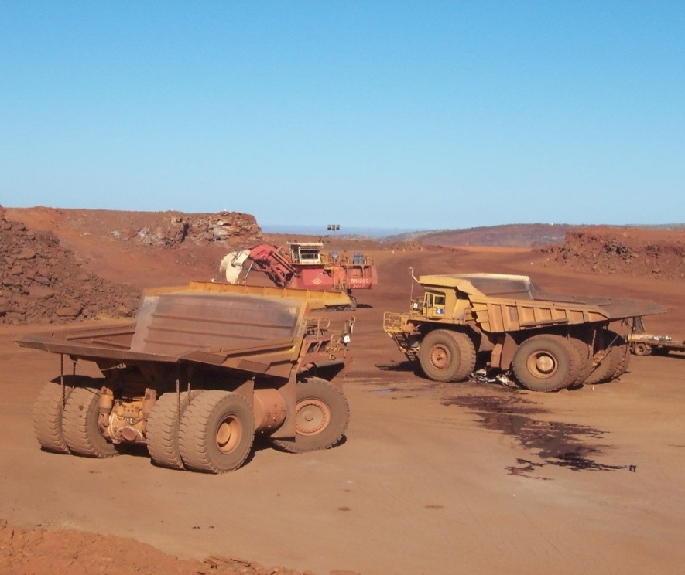
1. Introduction
2. Understanding Hazards
3. Understanding Risk
4. Risk Assessment
5. Risk Management
6. Review
Section 4 – Bowtie Analysis
Section 4 – Risk Analysis Methods
Let’s apply this to the example using the large haulage truck that ran over a small pickup truck that you saw in Section 2.
The first step is to identify the hazard. Mechanical energy in the form of moving equipment is a hazard.
#1
#2
Consequence 1
Consequence 2
Consequence 3
small pickup truck
26 of 37

Slide 84
1. Introduction
2. Understanding Hazards
3. Understanding Risk
4. Risk Assessment
5. Risk Management
6. Review
Section 4 – Bowtie Analysis
Section 4 – Risk Analysis Methods
The next step is to look at what could cause this unwanted event to happen? (What are the threats?)
On the next slide, write down what you think the threats are and then compare them to the list provided.
#1
#2
Consequence 1
Consequence 2
Consequence 3
small pickup truck
27 of 37

Slide 85
1. Introduction
2. Understanding Hazards
3. Understanding Risk
4. Risk Assessment
5. Risk Management
6. Review
Section 4 – Bowtie Analysis
Section 4 – Bowtie Analysis
Section 4 – Risk Analysis Methods
Threats
CLICK TO SEE A THREAT
CLICK TO SEE A THREAT
CLICK TO SEE A THREAT
CLICK TO SEE A THREAT
28 of 37

Slide 86
1. Introduction
2. Understanding Hazards
3. Understanding Risk
4. Risk Assessment
5. Risk Management
6. Review
Section 4 – Bowtie Analysis
Section 4 – Bowtie Analysis
Section 4 – Risk Analysis Methods
Threats
LARGE VEHICLES COLLIDE
TRUCK RUNS INTO SHOVEL
SHOVEL DUMPS ON SMALL VEHICLE
LARGE VEHICLE COLLIDES WITH SMALL VEHICLE
28 of 37

Slide 87
1. Introduction
2. Understanding Hazards
3. Understanding Risk
4. Risk Assessment
5. Risk Management
6. Review
Section 4 – Bowtie Analysis
We’ve only listed four for this example, but in a real analysis you would list all the threats that are identified.
Now let’s identify the consequences. This means to think about all the things that would be negatively affected if the unwanted event happens.
Consequences for this type of accident are injury to workers, emotional issues, fatality, damage to equipment, production loss, environmental damage and damage to a company’s reputation.
29 of 37

Slide 88
1. Introduction
2. Understanding Hazards
3. Understanding Risk
4. Risk Assessment
5. Risk Management
6. Review
Section 4 – Bowtie Analysis
Section 4 – Risk Analysis Methods
Control measures are put in place to avoid unwanted events. They can be training, design measures, or procedures. Match the example of control measures listed below with the type of control measure.reputation.
Training
Design
Pre-operational equipment check
Procedure
Driver training by type of vehicle
Identify blind spots
Barrier between lanes on a roadway
No driving or parking in blind spot
No passing rule
30 of 37

Slide 89
1. Introduction
2. Understanding Hazards
3. Understanding Risk
4. Risk Assessment
5. Risk Management
6. Review
Section 4 – Bowtie Analysis
Section 4 – Risk Analysis Methods
Control measures are put in place to avoid unwanted events. They can be design measures, procedures, practices or training. Match the control measures listed below with the type of control measure.tation.
Training
Design
Pre-operational equipment check
Procedure
Driver training by type of vehicle
Barrier between lanes on a roadway
Identify blind spots
No passing rule
No driving or parking in blind spot
30 of 37

Slide 90
1. Introduction
2. Understanding Hazards
3. Understanding Risk
4. Risk Assessment
5. Risk Management
6. Review
Section 4 – Bowtie Analysis
Section 4 – Risk Analysis Methods
Recovery measures are put in place to minimize the effects of the hazard or to recover from an unwanted event. This can include things such as:
.
First Aid and ambulance readiness
.
Signage showing right of way
Grief Counselling (post injury/fatality)
.
Vehicle approach alarms
Fire suppression system
Seat belts
31 of 37

Slide 91
1. Introduction
2. Understanding Hazards
3. Understanding Risk
4. Risk Assessment
5. Risk Management
6. Review
Section 4 – Bowtie Analysis
Section 4 – Risk Analysis Methods
You can see that this method is much more indepth and offers more insight than the Checklist, Qualitative Matrix or FEMAC.
It does require a larger team and more time to be done properly.
It is an effective method that can be used proactively before an unwanted event happens.
It is also an effective method that can be used after an unexpected event to identify hazards and it’s threats that were previously unidentified.
32 of 37

Slide 92
1. Introduction
2. Understanding Hazards
3. Understanding Risk
4. Risk Assessment
5. Risk Management
6. Review
Section 4 – Risk Assessment Team
Risk Assessments can be simple or complex. Fortunately this isn’t something you do alone. They are usually done with a group of people.
The number of people in the team will depend on the assessment being conducted.
Each person has a different perspective and experience which makes for a more complete assessment.
Facilitator
Prod. Mgr.
Engineer
Supervisor
Risk Assessment
Maint.
Supervisor
Operator
Safety
Rep
Subject
Expert
33 of 37

Slide 93
1. Introduction
2. Understanding Hazards
3. Understanding Risk
4. Risk Assessment
5. Risk Management
6. Review
Section 4 – Risk Assessment Team
The team also has a lot of information available to use in the assessment.
See the list below for some of the information available for use in a risk assessment.
Operating Procedures
Training Manuals and Records
Compliance Audits
Incident and Accident Investigations
Prestart Up Safety Reviews
Management of Change
Process Safety Information
34 of 37

Slide 94
1. Introduction
2. Understanding Hazards
3. Understanding Risk
4. Risk Assessment
5. Risk Management
6. Review
Section 4 – Test Your Knowledge
The Bowtie Risk Assessment has:
a) 4 parts - identify threats, identify consequences, determine control measures, and recovery measures.
b) 3 parts - identify hazards, consequences and threats.
c) 5 parts - identify hazards, threats, consequences, determine control measures and recovery measures.
d) none of the above.
SUBMIT
35 of 37

Slide 95
1. Introduction
2. Understanding Hazards
3. Understanding Risk
4. Risk Assessment
5. Risk Management
6. Review
Section 4 – Test Your Knowledge
2. A Failure Modes, Effects and Criticality Analysis is used:
a) Is a proactive way to identify where a failure in the hardware of a system might occur.
b) Is a reactive way to identify where a failure in the hardware of a system might occur.
c) Is a proactive way to identify where a failure in the hardware of a system might occur and to assess the impact of each possible failure.
SUBMIT
36 of 37

Slide 96
1. Introduction
2. Understanding Hazards
3. Understanding Risk
4. Risk Assessment
5. Risk Management
6. Review
Section 4 – Test Your Knowledge
3. A company has had 10 slip and fall accidents in the workshop in the last year. The accidents happen in an oil barrel storage area. The most serious injury was a broken wrist. What is the consequence of this type of accident?
a) Minor – A very minor incident, no lost time
b) Moderate – A lost time injury (short term)
c) Possible – Likely to occur sometime in the life of the plant
d) Certain – Likely to occur often during the life of the plant
SUBMIT
37 of 37

Slide 97
1. Introduction
2. Understanding Hazards
3. Understanding Risk
4. Risk Assessment
5. Risk Management
6. Review
Section 5 – Risk Management
You have been learning the key components of the process to manage risk in an operation (the blue boxes). How all the concepts relate to one another is shown in the diagram below:
Establish Context & Scope
Understand the Hazards
Communicate & Consult
Identify the Unwanted Events
Monitor & Review
Analyze & Evaluate Risks
Consider the Controls
Treat the Risks
1 of 17

Slide 98
1. Introduction
2. Understanding Hazards
3. Understanding Risk
4. Risk Assessment
5. Risk Management
6. Review
Section 5 – Risk Management
Establishing the context is important so that the company managing it’s workplace risk understands the environment they are working in.
For example, a new plant design that needs to be evaluated is a very different environment than an accident investigation. In each context (or environment), different risk assessment tools may be used.
A new plant design would likely use FMECA where as an accident investigation may use a Bowtie Analysis.
Establish Context & Scope
2 of 17

Slide 99
1. Introduction
2. Understanding Hazards
3. Understanding Risk
4. Risk Assessment
5. Risk Management
6. Review
Section 5 – Risk Management
The scope of a company’s risk management strategy is a description of what it will cover.
For example, the scope may be a strategy to cover:
Do Hazard Assessments for their site,
Create a Prevention Program, and
Create an Emergency Response Program
It is important to describe the boundaries of the risk management strategy to ensure the objectives are met. It helps to keep the focus on the important aspects of a company’s risk and usually has a deadline to ensure all items get completed.
Establish Context & Scope
3 of 17

Slide 100
1. Introduction
2. Understanding Hazards
3. Understanding Risk
4. Risk Assessment
5. Risk Management
6. Review
Section 5 – Risk Management
Once the scope and context are set, the next four steps are to understand the hazards, identify the unwanted events, analyze and evaluate the risks and consider existing controls or plan new ones. You have already learned the details of these in the previous sections.
Establish Context & Scope
Understand the Hazards
Communicate & Consult
Identify the Unwanted Events
Monitor & Review
Analyze & Evaluate Risks
Consider the Controls
Treat the Risks
4 of 17

Slide 101
1. Introduction
2. Understanding Hazards
3. Understanding Risk
4. Risk Assessment
5. Risk Management
6. Review
Section 5 – Risk Management
Communicate & Consult
Identify the Unwanted Events
Communicating and consulting once unwanted events are identified is crucial for all employees to understand what the potential for harm is in a plant.
Consultation with employees, safety personnel or subject matter experts will provide the best information to help make decisions about how to handle hazards and risk.
5 of 17

Slide 102
1. Introduction
2. Understanding Hazards
3. Understanding Risk
4. Risk Assessment
5. Risk Management
6. Review
Section 5 – Risk Management
Treating the risks is when a company takes action and makes changes to the workplace, policies, procedures, training or any other aspect of a work task that can contain a hazard and avoid an unwanted event.
Establish Context & Scope
Understand the Hazards
Communicate & Consult
Identify the Unwanted Events
Monitor & Review
Analyze & Evaluate Risks
Consider the Controls
Treat the Risks
6 of 17

Slide 103
1. Introduction
2. Understanding Hazards
3. Understanding Risk
4. Risk Assessment
5. Risk Management
6. Review
Section 5 – Risk Management
The last step is continual monitoring and review to make sure that the controls put in place and actions taken are really working. It is possible to miss a threat or have a new threat develop. The monitoring and review process can identify these so that proactive action can be taken and an unwanted event avoided.
Establish Context & Scope
Understand the Hazards
Communicate & Consult
Identify the Unwanted Events
Monitor & Review
Analyze & Evaluate Risks
Consider the Controls
Treat the Risks
7 of 17

Slide 104
1. Introduction
2. Understanding Hazards
3. Understanding Risk
4. Risk Assessment
5. Risk Management
6. Review
Section 5 – Risk Management
Companies develop Risk Management Plans to reduce the risk of harm from hazards that can’t be eliminated from a workplace.
This plan is usually a document describing how all risk in the company should be handled.
It will cover items such as:
Introduction
Hazards Identified
Risk Assessment
Training
Roles and Responsibilities
Audit & Review Processes
7. Management of Change
Plan Monitoring & Corrective Action
Communication
Record Keeping
Goods & Services Acquisition and control
8 of 17

Slide 105
1. Introduction
2. Understanding Hazards
3. Understanding Risk
4. Risk Assessment
5. Risk Management
6. Review
Section 5 – Risk Management
The Introduction will usually describe the company’s goals and objectives related to risk management. It will describe the purpose and structure of the plan.
The relevance of the plan to Acts, Regulations and laws are also discussed. Managing the health and safety of workers is legislated under the Occupational Health and Safety Act and is required.
The Hazard Identified section is a chapter that will change as hazards are eliminated or new ones identified. It will be used by the training department, reviewed by Health and Safety personnel and inspectors.
9 of 17

Slide 106
1. Introduction
2. Understanding Hazards
3. Understanding Risk
4. Risk Assessment
5. Risk Management
6. Review
Section 5 – Risk Management
The Risk Assessment section is a record of all the assessments done by a site. It will include the different techniques used and include reports or input from subject matter experts as needed.
The Training section will identify the type of training each different job requires with respect to hazard identification and risk assessment. It will set out what type of records of employee training need to be kept and how often employees will require retraining.
The Roles and Responsibilities section makes it clear who is responsible for what and when. This is important because everyone on a site has a role to play – from the worker up to the manager.
10 of 17

Slide 107
1. Introduction
2. Understanding Hazards
3. Understanding Risk
4. Risk Assessment
5. Risk Management
6. Review
Section 5 – Risk Management
Management of Change is a systematic approach to designed to deal with change in the organization. Its objectives are to identify, assess and evaluate impact of a change, recommend action(s) to implement and give authorization to proceed.
Change can be a modification to equipment, parts, materials, procedures or the introduction of new equipment, parts, materials or procedures.
Change can have a positive impact such as when it is implemented to eliminate an identified hazard.
Change can also introduce new hazards to a workplace unless it is reviewed by people who have the persons most knowledge on the subject.
11 of 17

Slide 108
1. Introduction
2. Understanding Hazards
3. Understanding Risk
4. Risk Assessment
5. Risk Management
6. Review
Section 5 – Risk Management
Plan Monitoring & Corrective Action How well the plan is working can only be known if a regular review of the practices, policies, procedures and accident frequency done. In this way deficiencies can be identified and corrected rather than have a failure in the plan result in an injury.
Communication to employees, management, between departments as well as government is important to the success of the plan. The Risk Management plan will describe how communication is to take place, when and in what form.
12 of 17

Slide 109
1. Introduction
2. Understanding Hazards
3. Understanding Risk
4. Risk Assessment
5. Risk Management
6. Review
Section 5 – Risk Management
The Audit and Review portion ensures that the plan is audited on a timely basis and reviewed for effectiveness.
Plan Monitoring & Corrective Action How well the plan is working can only be known if a regular review of the practices, policies, procedures and accident frequency done. In this way deficiencies can be identified and corrected rather than have a failure in the plan result in an injury.
Communication to employees, management, between departments as well as government is important to the success of the plan. The Risk Management plan will describe how communication is to take place, when and in what form.
13 of 17

Slide 110
1. Introduction
2. Understanding Hazards
3. Understanding Risk
4. Risk Assessment
5. Risk Management
6. Review
Section 5 – Risk Management
The Record Keeping and document management is also described so that vital information is not lost or destroyed. The plan will describe what records need to be kept, by who and for how long. The records may be used by the training department, government inspectors, and future investigations.
Finally, the Goods and Services Acquisition section is important as it describes how new products to the site need to be reviewed and assessed before they arrive and are used. This might be a new piece of equipment or a new chemical. Services means people who will come onto a site to do work. How they work, what they use for equipment, chemicals or procedures must also meet the company’s requirements for the protection of the contractors and site employees.
14 of 17

Slide 111
1. Introduction
2. Understanding Hazards
3. Understanding Risk
4. Risk Assessment
5. Risk Management
6. Review
Section 5 – Risk Management
The Risk Management Plan is a summary of how hazards and the associated risks are managed in a workplace.
Having a plan will not eliminate hazards or risks, but it will provide regular attention to how the site operates and will provide a safer workplace.
15 of 17

Slide 112
1. Introduction
2. Understanding Hazards
3. Understanding Risk
4. Risk Assessment
5. Risk Management
6. Review
Section 5 – Test Your Knowledge
Once a hazard has been identified, the risk assessed and control measures put in place, a company has solved the problem and doesn’t have to worry about it anymore.
True
False
SUBMIT
16 of 17

Slide 113
1. Introduction
2. Understanding Hazards
3. Understanding Risk
4. Risk Assessment
5. Risk Management
6. Review
Section 5 – Test Your Knowledge
Which of the following lists are part of a Risk Management Plan?
a) Hazard Identification, Risk Assessment, Roles & Responsibilities
b) Risk Management Process, Introduction, Record Keeping
c) Risk Management Journey, Training, Audit & Review
d) Communication, Plan Monitoring & Correction, Government Approval & Permission
SUBMIT
17 of 17

Slide 114
1. Introduction
2. Understanding Hazards
3. Understanding Risk
4. Risk Assessment
5. Risk Management
6. Review
Section 6 – Review
Section 4 – Risk Analysis Methods
In this module you have learned what Risk Management is and why it is important. Let’s review the key points.
A hazard is a source of potential harm.
An unwanted event is a potential situation where the hazard can be released.
Hazards
1 of 18

Slide 115
1. Introduction
2. Understanding Hazards
3. Understanding Risk
4. Risk Assessment
5. Risk Management
6. Review
Section 6 – Review
Section 4 – Risk Analysis Methods
You can prevent an unwanted event if you identify the hazard.
Look for a source of energy such as:
Gravity
Electricity
Mechanical
Chemical
Pressure
Noise
Thermal
Radiant
Body Mechanics
Falling or things falling
Contact or arcing
Moving equipment or moving parts
Inhalation, touching or ingesting
Air or a spring or compressed gas
How loud and how long you hear it
Hot or cold
Light or radiation
Lifting or body position
2 of 18

Slide 116
1. Introduction
2. Understanding Hazards
3. Understanding Risk
4. Risk Assessment
5. Risk Management
6. Review
Section 6 – Review
The best way to deal with hazards is to eliminate them. If this is not possible, then controls are needed to reduce the risk of harm.
Elimination
Most Effective
Substitution
Engineering
Administration
PPE
Least Effective
Personal Protective Equipment (PPE) should always be your last choice.
3 of 18

Slide 117
1. Introduction
2. Understanding Hazards
3. Understanding Risk
4. Risk Assessment
5. Risk Management
6. Review
Section 6 – Review
Risk is defined as the chance of something happening that will have a negative impact on objectives.
As an example we saw that high risk was a result of high probability and high consequence.
Risk = Probability of Occurrence x Consequence of the Outcome
HIGH
HIGH
HIGH
(Probability of Occurrence)
(Outcome Consequence)
(Risk)
4 of 18

Slide 118
1. Introduction
2. Understanding Hazards
3. Understanding Risk
4. Risk Assessment
5. Risk Management
6. Review
Section 6 – Review
Section 3 – Understanding Risk
So if the Probability of Occurrence =
and the Consequence of the Outcome =
then the Risk of an unwanted event is
HIGH
HIGH
HIGH
HIGH
HIGH
(Probability of Occurrence)
(Outcome Consequence)
(Risk)
5 of 18

Slide 119
1. Introduction
2. Understanding Hazards
3. Understanding Risk
4. Risk Assessment
5. Risk Management
6. Review
Section 6 – Review
Section 3 – Understanding Risk
Once hazards and risks are identified, a risk assessment can be done. A Qualitative Risk Assessment can be done by creating a matrix of probability versus consequence.
 | Consequence
 | 1 Insignificant | 2 Minor | 3 Moderate | 4 Major | 5 Catastrophic
5 Certain | HIGH | HIGH | EXTREME | EXTREME | EXTREME
4 Likely | MEDIUM | HIGH | HIGH | EXTREME | EXTREME
3 Possible | LOW | MEDIUM | HIGH | EXTREME | EXTREME
2 Unlikely | LOW | LOW | MEDIUM | HIGH | EXTREME
1 Rare | LOW | LOW | MEDIUM | MEDIUM | HIGH
Probability
6 of 18

Slide 120
1. Introduction
2. Understanding Hazards
3. Understanding Risk
4. Risk Assessment
5. Risk Management
6. Review
Section 4 – Qualitative Risk Assessment
Section 6 – Review
Section 4 – Risk Analysis Methods
Definitions – Probability (Likelihood)
Definitions for the terms in the matrix are needed for both the likelihood (probability) and consequence.
Certain
Likely to occur often during the life of the operation
Likely
Likely to occur several times in the life of the operation
Possible
Likely to occur sometime in the life of the operation
Unlikely
Unlikely, but possible to occur.
Rare
So unlikely it is assumed not to occur .
7 of 18

Slide 121
1. Introduction
2. Understanding Hazards
3. Understanding Risk
4. Risk Assessment
5. Risk Management
6. Review
Section 4 – Qualitative Risk Assessment
Section 6 – Review
Section 4 – Risk Analysis Methods
Definitions – Consequence
Catastrophic
Death, loss of plant, release to environment with pubic interest, regulatory intervention occurs
Major
Permanent impairment, serious lost time injury, partial loss of plant, lesser release to environment
Moderate
Lost time injury (short term), short term loss of plant, recoverable release to the environment
Minor
Minor injury, minor damage to plant, minor confined environmental exposure
Insignificant
Very minor incident, less than any of the above.
8 of 18

Slide 122
1. Introduction
2. Understanding Hazards
3. Understanding Risk
4. Risk Assessment
5. Risk Management
6. Review
Section 6 – Review
Section 4 – Risk Assessment Tools
There are other Risk Assessment tools that can be used in addition to Qualitative Risk Analysis such as:
Checklist
Failure Modes, Effects & Criticality Analysis (FMECA)
Bow Tie Analysis
Event Tree / Logic Tree Analysis
HAZOP Analysis
Workplace Risk Assessment and Control (WRAC)
9 of 18

Slide 123
1. Introduction
2. Understanding Hazards
3. Understanding Risk
4. Risk Assessment
5. Risk Management
6. Review
Section 4 – Failure Modes, Effects & Criticality Analysis
Section 6 – Review
Section 4 – Risk Analysis Methods
Failure Modes, Effects and Criticality Analysis is done to determine proactively where a failure in the hardware of a system may occur and to assess the impact of each possible failure.
List
Failure Modes
Determine Effects
Evaluate Effects
Control
10 of 18

Slide 124
1. Introduction
2. Understanding Hazards
3. Understanding Risk
4. Risk Assessment
5. Risk Management
6. Review
Section 4 – Bowtie Analysis
Section 6 – Review
Section 4 – Risk Analysis Methods
A Bowtie Analysis is done in 5 steps, first identify the hazard, determine the possible threats and consequences for each threat.
Then controls and recovery measures are determined to mitigate the risk.
Threat 1
Hazard
Consequence 1
Threat 2
Controls
Recovery
Consequence 2
Threat 3
Consequence 3
11 of 18

Slide 125
1. Introduction
2. Understanding Hazards
3. Understanding Risk
4. Risk Assessment
5. Risk Management
6. Review
Section 6 – Review
The Risk Assessment Team
Regardless of the type of Risk Assessment done, a group of people is usually assigned to perform the assessment.
Each person has a different perspective and experience which makes for a more complete assessment.
Facilitator
Prod. Mgr.
Engineer
Supervisor
Risk Assessment
Maint.
Supervisor
Operator
Safety
Rep
Subject
Expert
12 of 18

Slide 126
1. Introduction
2. Understanding Hazards
3. Understanding Risk
4. Risk Assessment
5. Risk Management
6. Review
Section 6 – Review
The complete process includes scope, context, implementation of controls, communication and ongoing monitoring and review.
Establish Context & Scope
Understand the Hazards
Communicate & Consult
Identify the Unwanted Events
Monitor & Review
Analyze & Evaluate Risks
Consider the Controls
Treat the Risks
13 of 18

Slide 127
1. Introduction
2. Understanding Hazards
3. Understanding Risk
4. Risk Assessment
5. Risk Management
6. Review
Section 6 – Review
Companies develop Risk Management Plans to reduce the risk of harm from hazards that can’t be eliminated from a workplace.
This plan is usually a document describing how all risk in the company should be handled and will cover topics such as:
Introduction
Hazards Identified
Risk Assessment
Training
Roles and Responsibilities
Audit & Review Processes
7. Management of Change
Plan Monitoring & Corrective Action
Communication
Record Keeping
Goods & Services Acquisition and control
14 of 18

Slide 128
1. Introduction
2. Understanding Hazards
3. Understanding Risk
4. Risk Assessment
5. Risk Management
6. Review
Section 6 – Review
The Risk Management Plan is a summary of how hazards and the associated risks are managed in a workplace.
Having a plan will not eliminate hazards or risks, but it will provide regular attention to how the site operates and will provide a safer workplace.
This is the end of the review. If you are ready you can go on to the final quiz. If not, take time and review any of the sections before you go on. You will need to achieve a perfect score to receive credit for this module.
15 of 18

Slide 129
1. Introduction
2. Understanding Hazards
3. Understanding Risk
4. Risk Assessment
5. Risk Management
6. Review
Section 6 – References
www.ironring.ca
Holgate, Henry; Derry, John, G. G.; Galbraith, John. (1908). Royal Commission Quebec Bridge Inquiry Report. Sessional Paper No 154. S.E. Dawson printer to the King Ottawa. App. 19, Figure 20; scan found at http://matdl.org/failurecases/Bridge_Collapse_Cases/Quebec_Bridge
http://www.mishc.uq.edu.au/
Minerals Industry Safety and Health Risk Management Guideline, Department of Primary Industries, New South Wales, Australia
Wikimedia Commons: http://commons.wikimedia.org/wiki/Main_Page
Risk Management Professional: http://www.rmprofessional.com/
Risk Management Corporation Risk Management Seminar Series: http://www.youtube.com/view_play_list?p=05BAD95091231CF7
Management of Change Training Seminar, Xstrata Nickel, August 2013
16 of 18

Slide 130
1. Introduction
2. Understanding Hazards
3. Understanding Risk
4. Risk Assessment
5. Risk Management
6. Review
Section 6 – Other Websites for Workplace Safety
http://www.worksafebc.com (BC)
http://www.safetyauthority.ca (BC)
http://humanservices.alberta.ca (Alberta)
http://www.worksafesask.ca (Saskatchewan)
http://safemanitoba.com (Manitoba)
http://www.workplacesafetynorth.ca (Ontario)
http://www.csst.qc.ca/en/youth/Pages/young_people_work.aspx (QC)
http://www.worksafenb.ca/ (New Brunswick)
http://www.servicenl.gov.nl.ca/ohs/ (Newfoundland & Labrador)
http://www.wscc.nt.ca/Pages/default.aspx (NWT & Nunavut)
http://novascotia.ca/lae/ohs/ (Nova Scotia)
http://www.wcb.pe.ca/ (PEI)
http://wcb.yk.ca/ (Yukon)
17 of 18

Slide 131
1. Introduction
2. Understanding Hazards
3. Understanding Risk
4. Risk Assessment
5. Risk Management
6. Review
Section 6 – Acknowledgements
THANK YOU! to our sponsors:
18 of 18

